Slide 1
Hello Everyone My Project Name: BSMRSTU Teachers Record Database Course code: CSE 178
Project Supervisor:
Md. Jamal Uddin
Assistant Professor
Department of CSE, BSMRSU,Gopalganj-8100
Submitted By:
Anik Kumar
Student ID: 19CSE003
Department of CSE,
BSMRSTU,Gopalganj-8100

Slide 2
Presentation Outline
Introduction
The process of Project
Features
Some Snapshots
Result & Evaluations
Future plan
Conclusion

Slide 3
Introduction
Teachers record database program is a simple apps , which we can find teacher details, add teacher details and we can update their details.
The teacher management system is an automated version of manual teacher Management System.

Slide 4
The process of Project
You will be given 7 tasks of output and if you want you will be able to choose the task.
First task, if a new teacher join in our university then click 1.
Next, If Searching a teacher in our university then click 2.
Type 3 , view to all teacher list in our university.
Type 4 and 5 to update data and delete data respectively.
Then, Type 6 to see a list of all faculty and departmental teachers.
Finally, this program exits when you type 7.

Slide 5
Features
Every Students can be quickly find any teacher and help from him.
If you want the title of teachers you can change or view.
You can find teachers phone numbers, Email Or you can change it if you want.
Every department will be able to find teachers.
If A new teacher join in our university then add in his data.
If A teacher transfer or retiring then we can delete his data from file.
University teachers can count.

Slide 6
Some Snapshots
Sample Code Using two file
When code is run
Teachers list output
Search Teacher
List of Faculty
List of department
When exit the program

Slide 7
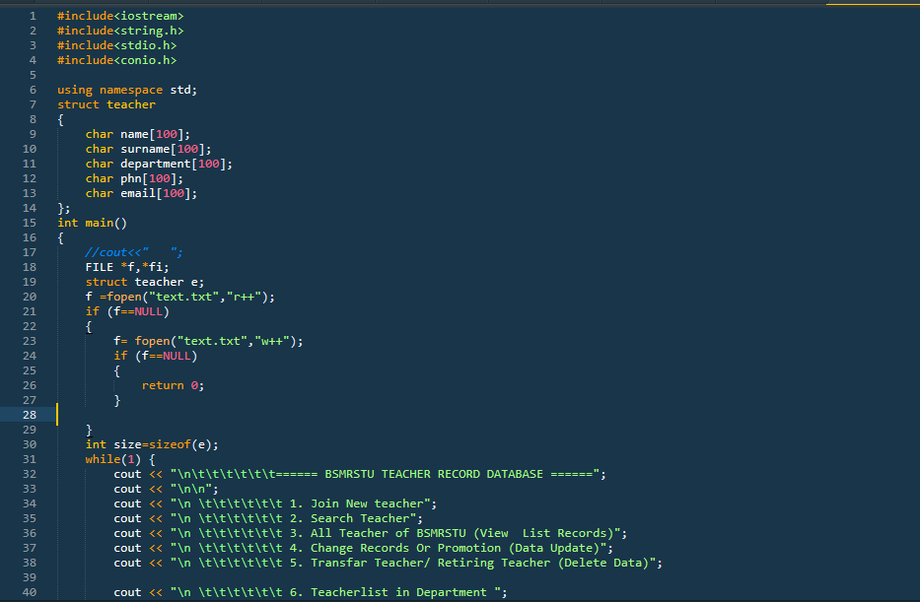
Sample Code Using two file

Slide 8
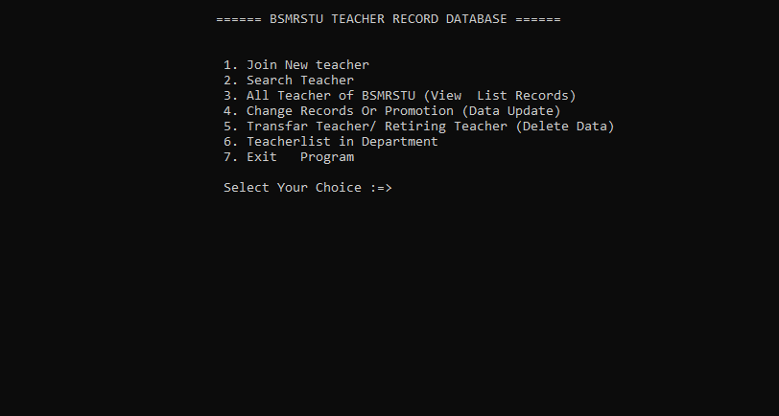
When code is run

Slide 9
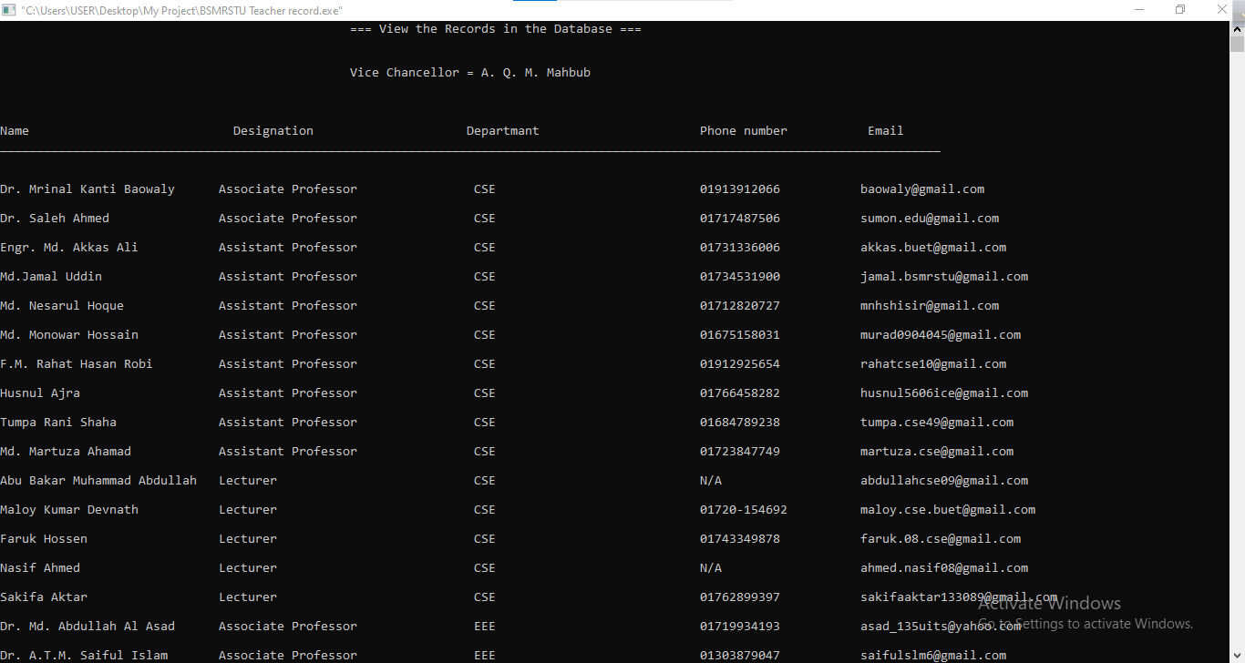
Teachers list output

Slide 10
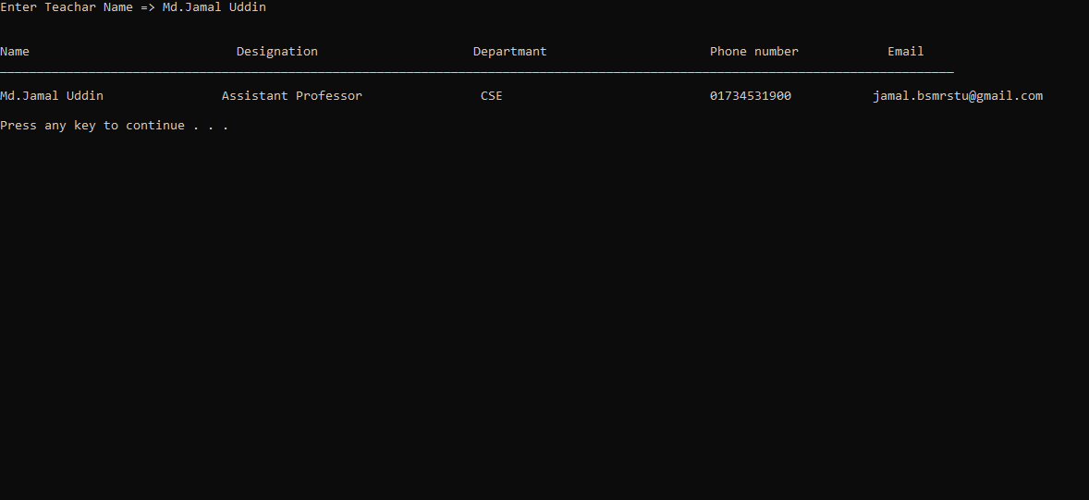
Search Teacher

Slide 11
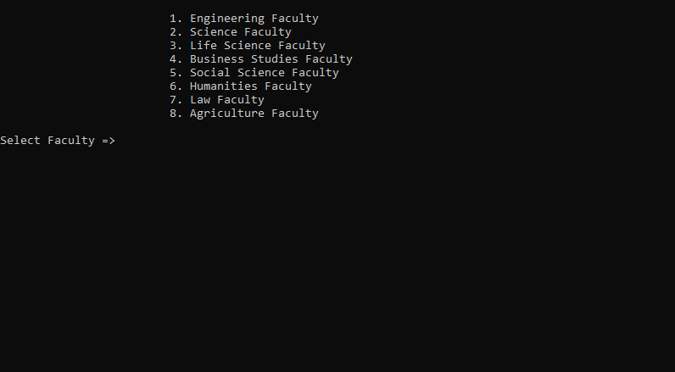
List of Faculty

Slide 12
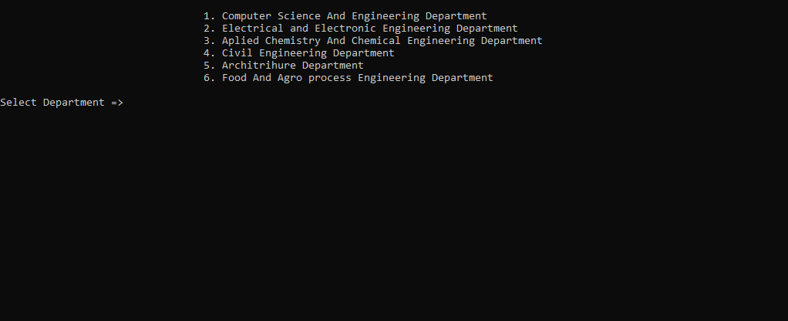
List of department

Slide 13
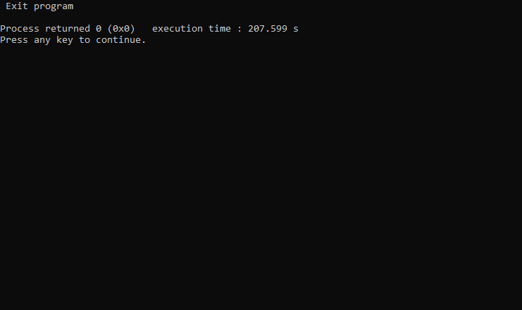
When exit the program

Slide 14
Future plan
It needs to be made more workable in the form of applications and there is a desire to create separate versions for mobile and PC and that will be.
I will add the graphic later.
If you work harder, you will have to upload it to the Play Store separately for Windows, Linux, Mac.

Slide 15
Conclusion
It is a wonderful and learning experience for us while working of on this project.
This software is very easy to use so our educational institute can use this frequently.
So I can hope that my software will be very popular and get sponsors to develop in future

Slide 16
Thank You
Everyone

